Slide 1
B.Tech Integrated Mid-Term Presentation
A.Y. 2021-2022 Project Title: Disease Detection System using Machine Learning
Presented by: Vaibhav Raheja (C056)
Viraj Shah (C064)
Mayank Shetty (C075)
Purav Patel (C098)
Under The Guidance of: Prof. Manisha Tiwari

Slide 2
Roadmap
Introduction
Literature Review
Proposed System
Proposed Algorithm
Architecture Diagram
References

Slide 3

Machine Learning in Disease Detection
Machine learning (ML) is the study of computer algorithms that improve automatically through experience and by the use of data.
It is seen as a part of Artificial Intelligence (AI).
Machine learning algorithms build a model based on sample data, to make decisions without any explicit programming.

Slide 4
Literature Review
Link for Literature Review

Slide 5
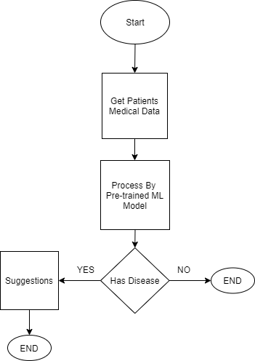
Proposed System

Slide 6
Proposed Algorithm
Algorithm for machine learning for Chronic Kidney Disease Detection
Logistic Regression
Random Forest
Algorithm for machine learning for Diabetes Detection:
K-Nearest Neighbour
Logistic Regression

Slide 7
Proposed Algorithm
Algorithm for machine learning for Heart Disease Detection
Decision Tree
Random Forest Regression
Algorithm for machine learning for Pneumonia
Convolutional Neural Network
Support Vector Machine (SVM)

Slide 8
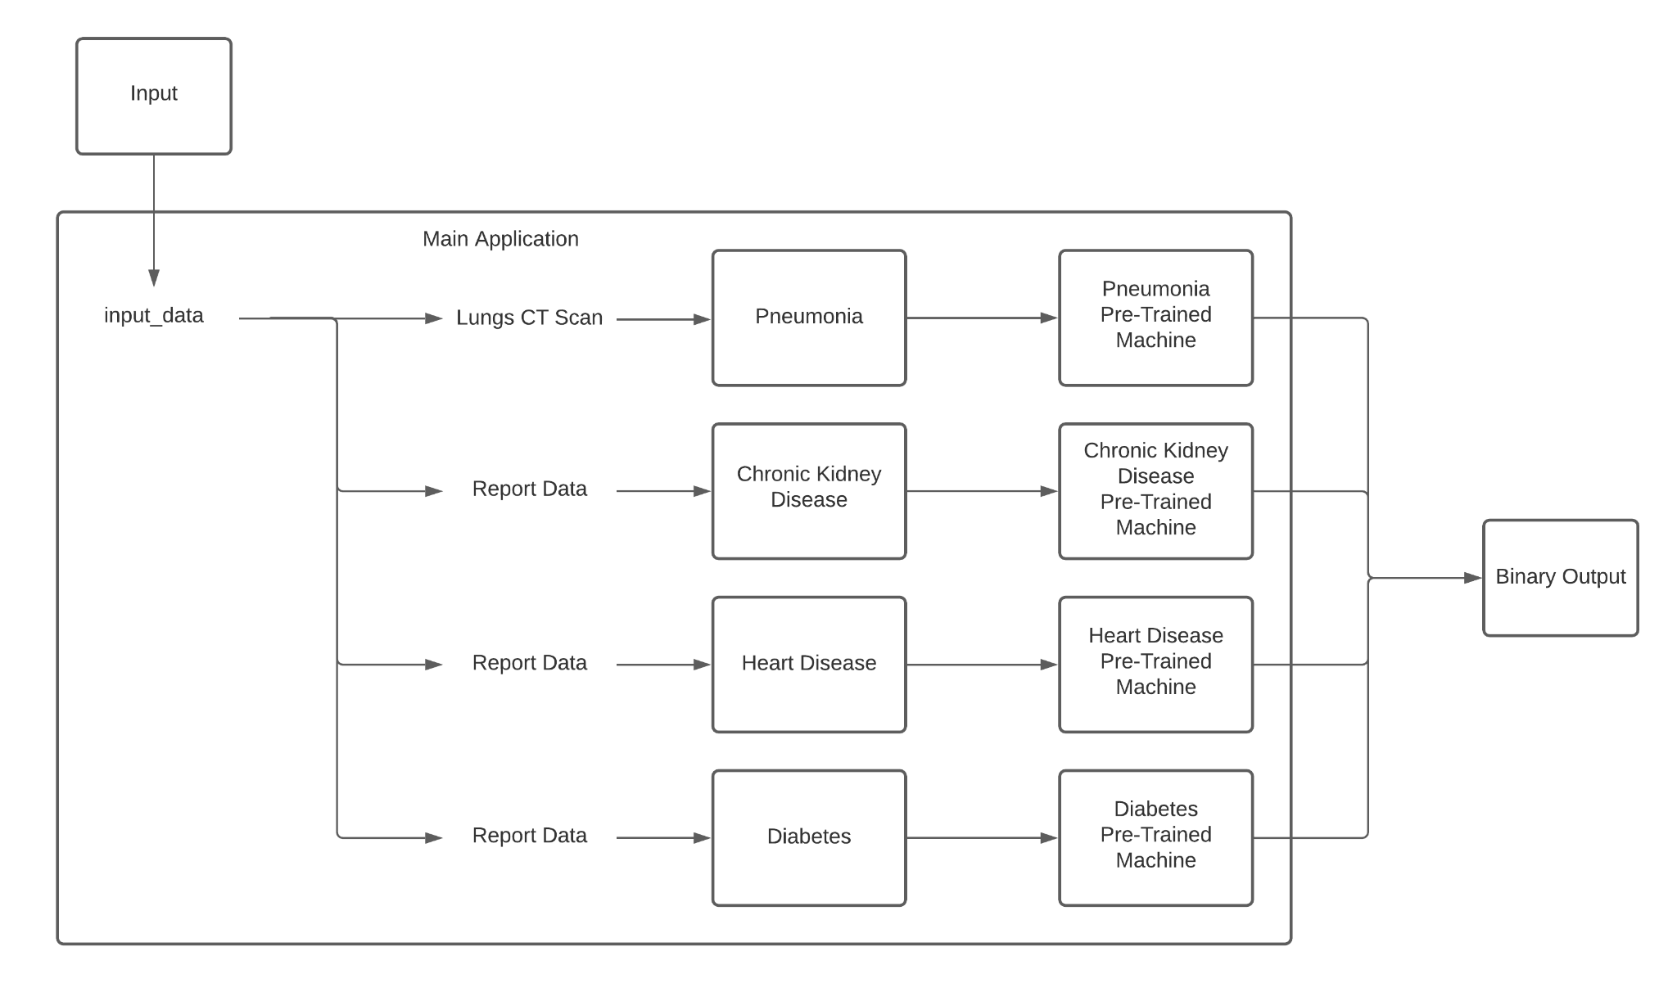
Architecture Diagram

Slide 9
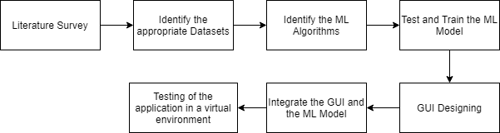
Plan of Action

Slide 10
References
[1] J. J. Khanam, S. Y. Foo, “A comparison of machine learning algorithms for diabetes prediction”, ICT Express (Feb. 2021), 2021, doi: 10.1016/J.ICTE.2021.02.004.
[2] D. Shetty, K. Rit, S. Shaikh and N. Patil, "Diabetes disease prediction using data mining," 2017 International Conference on Innovations in Information, Embedded and Communication Systems (ICIIECS), 2017, pp. 1-5, doi: 10.1109/ICIIECS.2017.8276012.
[3] A. Mujumdar, V. Vaidehi, “Diabetes Prediction using Machine Learning Algorithms”, Procedia Computer Science, Volume 165, 2019, pp. 292-299, doi: 10.1016/J.PROCS.2020.01.047.
[4] S. K. Dey, A. Hossain and M. M. Rahman, "Implementation of a Web Application to Predict Diabetes Disease: An Approach Using Machine Learning Algorithm," 2018 21st International Conference of Computer and Information Technology (ICCIT), 2018, pp. 1-5, doi: 10.1109/ICCITECHN.2018.8631968.
[5] M. Kavitha, G. Gnaneswar, R. Dinesh, Y. R. Sai and R. S. Suraj, "Heart Disease Prediction using Hybrid Machine Learning Model," 2021 6th International Conference on Inventive Computation Technologies (ICICT), 2021, pp. 1329-1333, doi: 10.1109/ICICT50816.2021.9358597.
[6] F. Alotaibi, “Implementation of Machine Learning Model to Predict Heart Failure Disease”, International Journal of Advanced Computer Science and Applications (IJACSA), 10(6), 2019, doi: 10.14569/IJACSA.2019.0100637.
[7] J. Qin, L. Chen, Y. Liu, C. Liu, C. Feng and B. Chen, "A Machine Learning Methodology for Diagnosing Chronic Kidney Disease," in IEEE Access, vol. 8, pp. 20991-21002, 2020, doi: 10.1109/ACCESS.2019.2963053.
[8] R. Gupta, N. Koli, N. Mahor and N. Tejashri, "Performance Analysis of Machine Learning Classifier for Predicting Chronic Kidney Disease," 2020 International Conference for Emerging Technology (INCET), 2020, pp. 1-4, doi: 10.1109/INCET49848.2020.9154147.
[9] F. M. Javed Mehedi Shamrat, P. Ghosh, M. H. Sadek, M. A. Kazi and S. Shultana, "Implementation of Machine Learning Algorithms to Detect the Prognosis Rate of Kidney Disease," 2020 IEEE International Conference for Innovation in Technology (INOCON), 2020, pp. 1-7, doi: 10.1109/INOCON50539.2020.9298026.
[10] D. Varshni, K. Thakral, L. Agarwal, R. Nijhawan and A. Mittal, "Pneumonia Detection Using CNN based Feature Extraction," 2019 IEEE International Conference on Electrical, Computer and Communication Technologies (ICECCT), 2019, pp. 1-7, doi: 10.1109/ICECCT.2019.8869364. [11] A. Sharma, M. Negi, A. Goyal, R. Jain and P. Nagrath, “Detection of Pneumonia using ML & DL in Python.”, IOP Conference Series: Materials Science and Engineering 1022, 2021, doi: 10.1088/1757-899X/1022/1/012066.

